Slide 1
Predicting Stroke Risk
Exploring the Relationship between Demographic Factors and Health Indicators

Slide 2

Goal
Address challenges by developing
a reliable stroke prediction model:
Provide personalized risk assessments
Understand one’s own susceptibility to stroke
Take proactive steps to reduce one’s risk

Slide 3

Data Collection
The dataset was collected from Kaggle Playground Competition:
Predicts whether a patient is likely to have a stroke based on the input parameters
Consists 12 features

Slide 4
Data Features
id
gender
age
bmi
Unique identifier for each individual
Gender of the individual
(Male or Female)
Age of the individual
Body mass index (BMI)
of the individual
hypertension
heart_disease
ever_married
smoking_status
Whether the individual has high blood pressure
(Yes=1, No=0)
Whether the individual has a heart disease
(Yes=1, No=0)
Whether the individual is married
(Yes or No)
Smoking status of the individual
work_type
residence_type
avg_glucose_level
stroke
Type of work the individual is engaged in
(i.e. Private, Self-employed, etc.)
Type of residence of the individual
(Urban or Rural)
Average glucose level in the individual’s blood
Whether the invidual has had a stroke
(Yes=1, No=0)

Slide 5
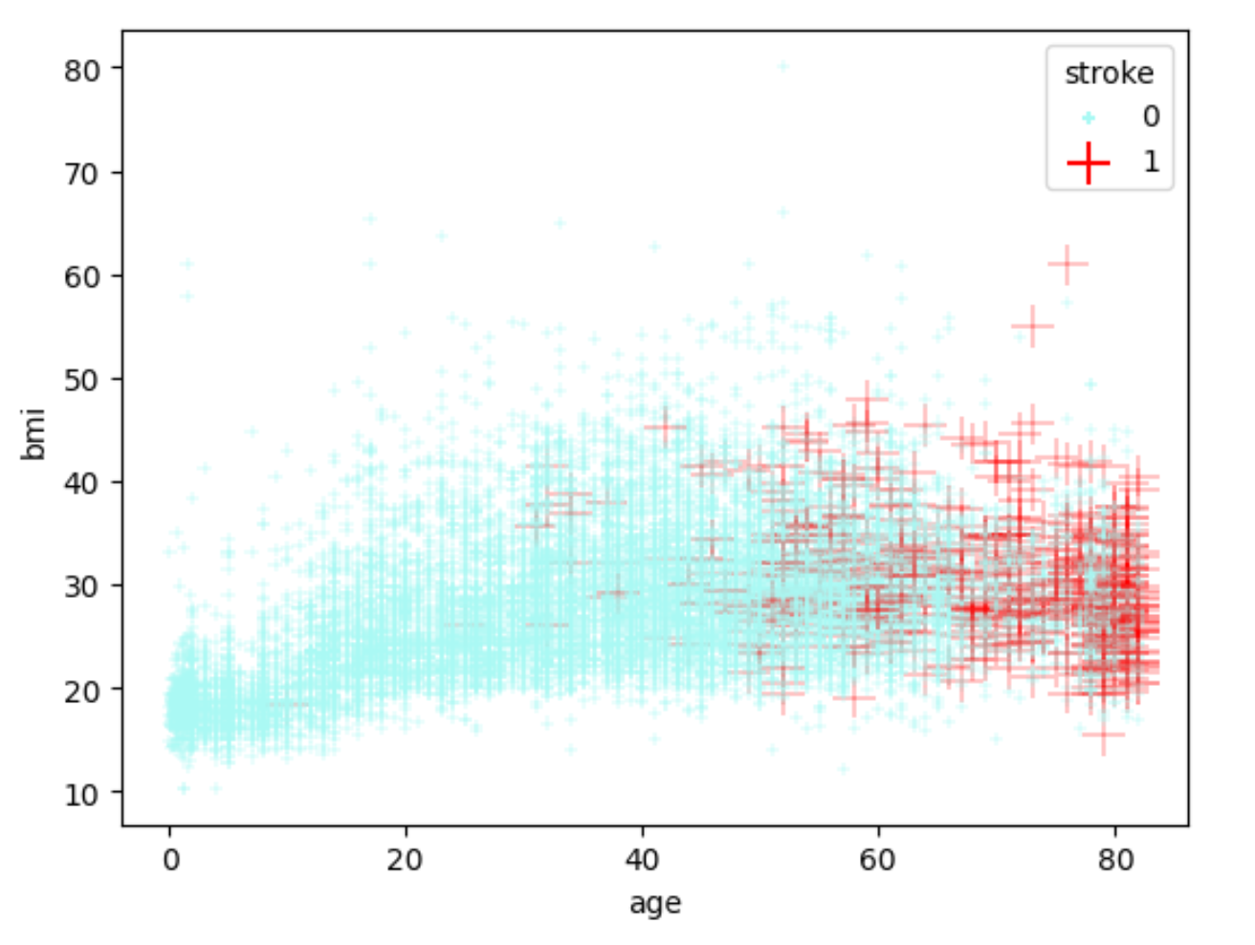
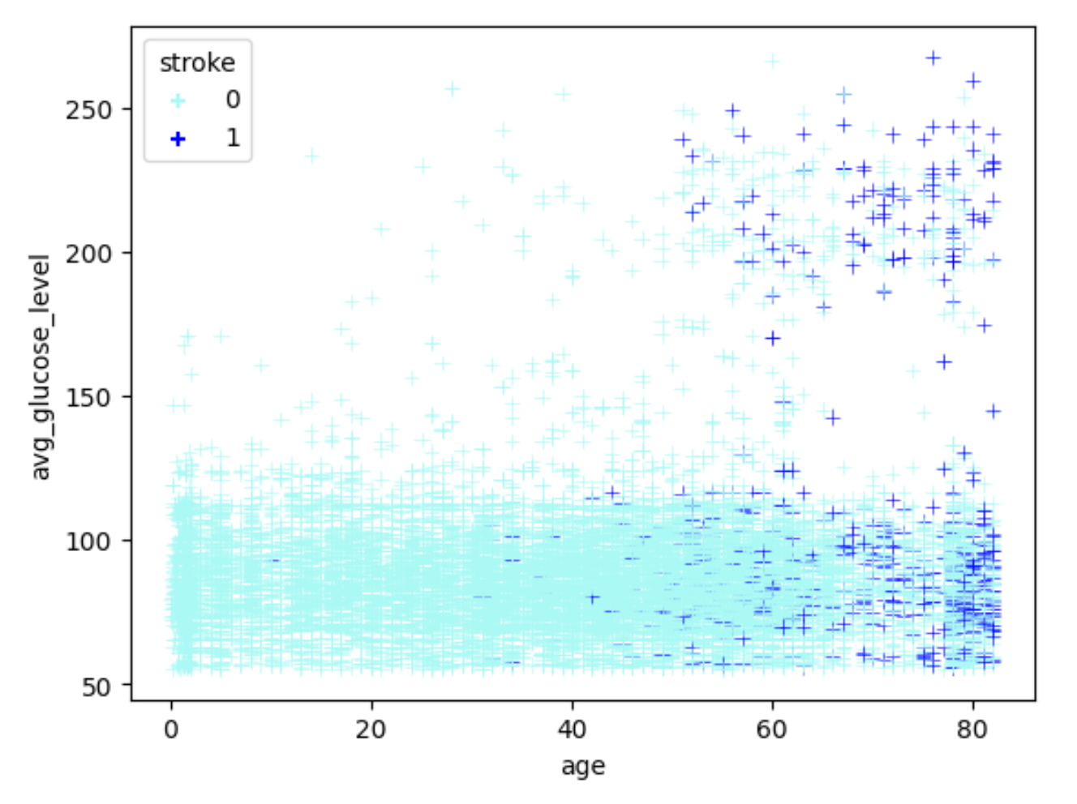
Visualization Process
Highest correlation between age and stroke
avg_glucose_level separating into two groups: below 125 and above 180

Slide 6
Building Pipeline
ColumnTransformer
num_std
num_log
num_power
num_minmax
num
cat
SimpleImputer
SimpleImputer
SimpleImputer
SimpleImputer
SimpleImputer
SimpleImputer
FunctionTransformer
PowerTransformer
OrdinalEncoder
std_scaler: Pipeline
Minmax_transformer: Pipeline
StandardScaler
MinMaxScaler

Slide 7
Results

Slide 8
Limitation & Suggestion

Slide 9
References
[1] https://slidesgo.com/
[2] https://www.kaggle.com/competitions/playground-series-s3e2/
[3] H.-K. Wang et al., “Smoking paradox in stroke survivors? - aha/ASA journals,” Smoking Paradox in Stroke Survivors?, https://www.ahajournals.org/doi/pdf/10.1161/STROKEAHA.119.027012 (accessed Jun. 30, 2023).
[4] “Diabetes tests,” Centers for Disease Control and Prevention, https://www.cdc.gov/diabetes/basics/getting-tested.html (accessed Jun. 30, 2023).
[5] “Stroke,” Stroke | ADA, https://diabetes.org/diabetes/stroke#:~:text=If%20you%20have%20diabetes%2C%20your,risk%20of%20getting%20a%20stroke (accessed Jun. 30, 2023).
[6] M. Tobias Kurth, “Body mass index and the risk of stroke in men,” Archives of Internal Medicine, https://jamanetwork.com/journals/jamainternalmedicine/fullarticle/754810 (accessed Jun. 30, 2023).

